Slide 1
Condensed Matter and Materials Physics
Theme Leader: Brendon Lovett Speaker: Ian Galbraith
CMMP Activities: Edinburgh, Glasgow, St Andrews, Strathclyde
Dundee, Aberdeen, Heriot-Watt, UWS
Facilities:
Ultra-low-vibration lab, new cleanrooms, and oxide MBE facility (St Andrews); CSEC high-pressure labs (Edinburgh);
MagTEM and xenon plasma FIB (Glasgow);
2D materials, photonics and device fabrication facility (Heriot-Watt).
Centre for Doctoral Training:
3rd incarnation of Scottish CM-CDT into 2nd round as
‘CDT in Physics of Quantum Materials’

Slide 2
Existing Scope of Theme
Core topics:
Correlated systems, novel phases of matter, advanced quantum materials (St A., Edi.)
Microscopy for functional materials (Glas., Strath.)
Soft condensed matter (Edi.)
Nanomaterials and quantum information (H-W, St A.)
Optoelectronic devices (St A., Glas., Strath., H-W.)
Electron paramagnetic resonance (St A., Dundee)
Thin films, sensors, and imaging (UWS)
Some Areas of overlap with other themes:
Biological physics (Edi., Abdn, Dundee) – PALS.
Solid oxide fuel cells (Abdn) – Energy.
Organic LEDs and photovoltaics (St A., Strath., H-W) – Energy.
Laser-engineered surface structures (Dundee) – Particle Physics.
Single-photon sources (Heriot-Watt) – Photonics.

Slide 3
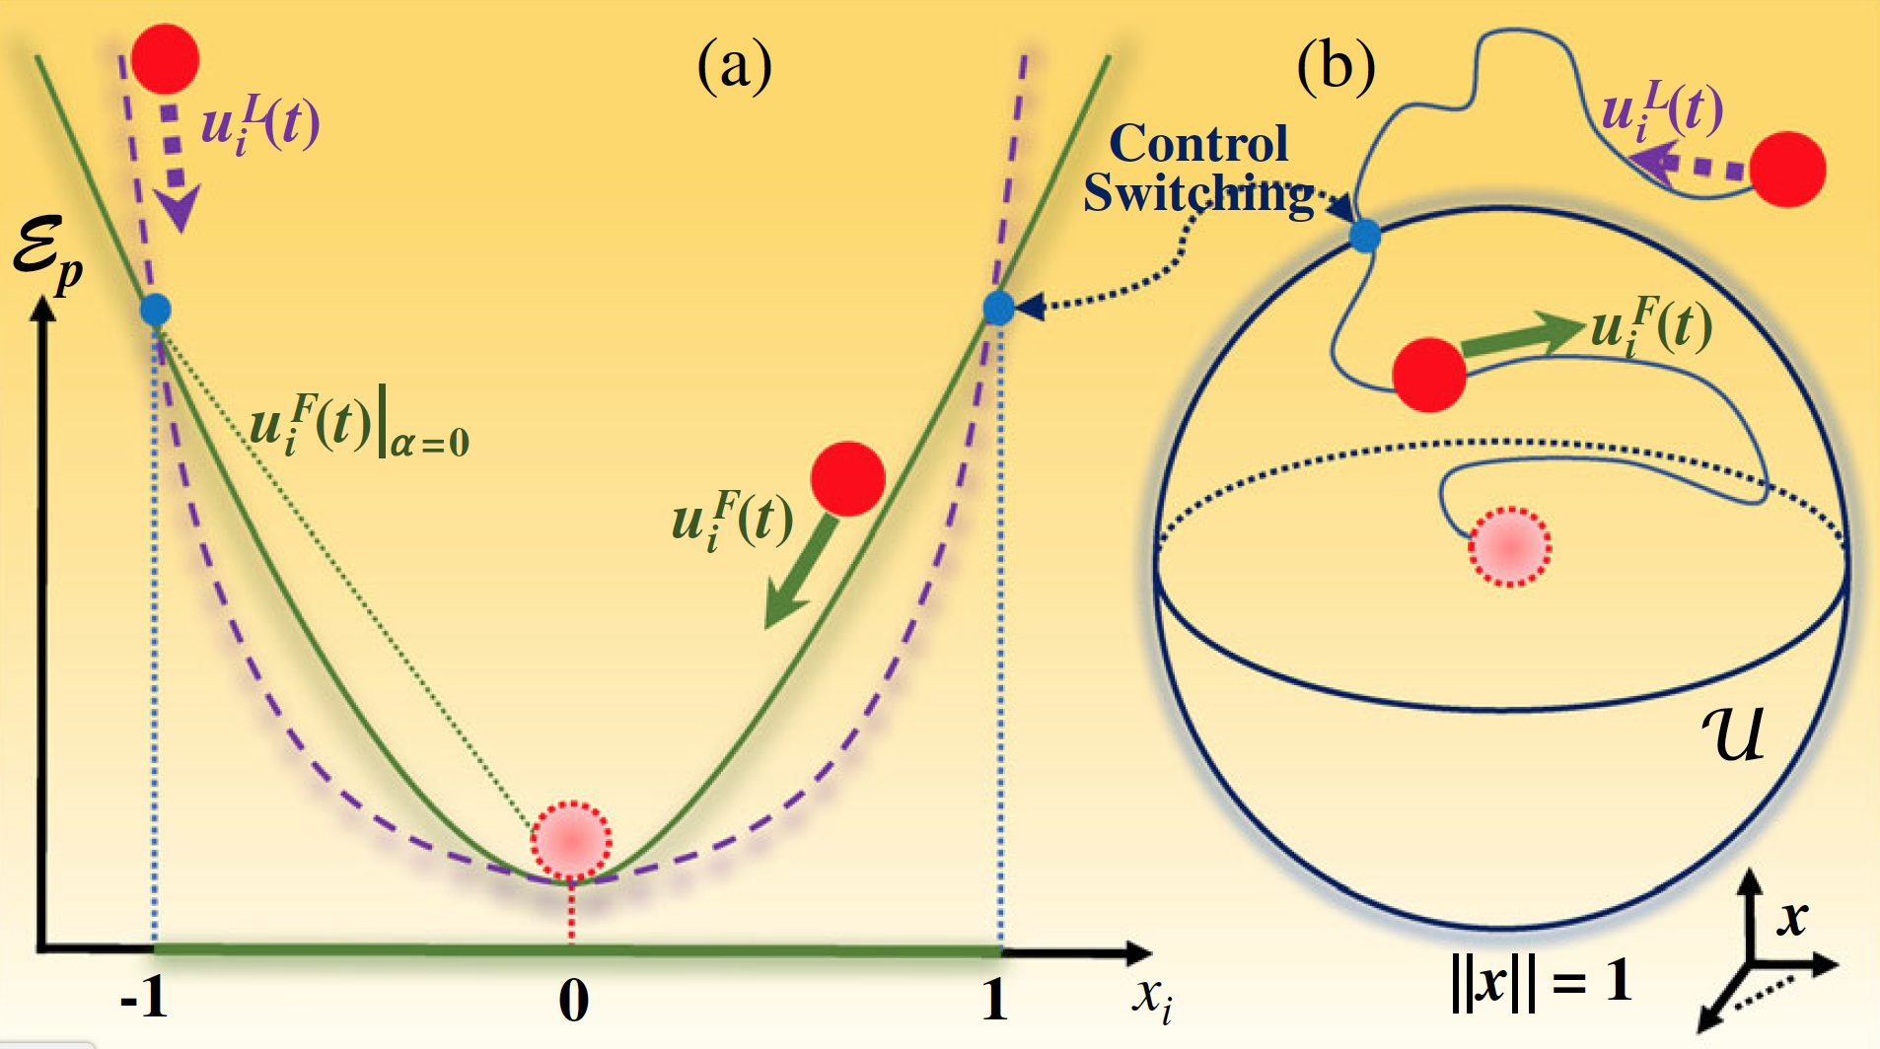
Illustrative Examples
Control of
Complex Networks
Controlling Atom-Atom Coupling
(St Andrews/Stanford)
Using optical cavities
Phys. Rev. X 8 011002 (2018)
Readout of Ferroelectrics
(St Andrews)
Dynamic Domain walls,
Nature Materials 17 49-56 (2018)
(Aberdeen)
Predicting tipping points.
Proc. Nat. Acad. Sci. . 115,
E639 (2018)

Slide 4
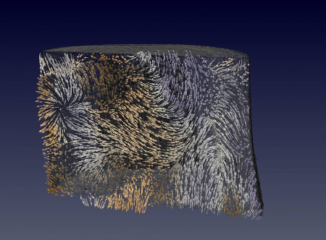
Illustrative Examples (contd.)
Magnetic Ratchet (Glasgow)
Tomography and high energy x-rays reveals magnetic singularities
Nature Materials 16 1106 (2017)
Strongly Coupled Nano-mechanical Resonator Modes (H-W)
Nonlinear mechanical frequency mixing
Phys. Rev. Lett. 118, (2017).

Slide 5
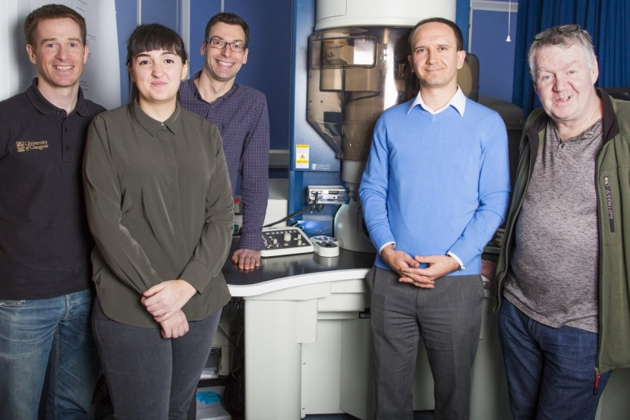
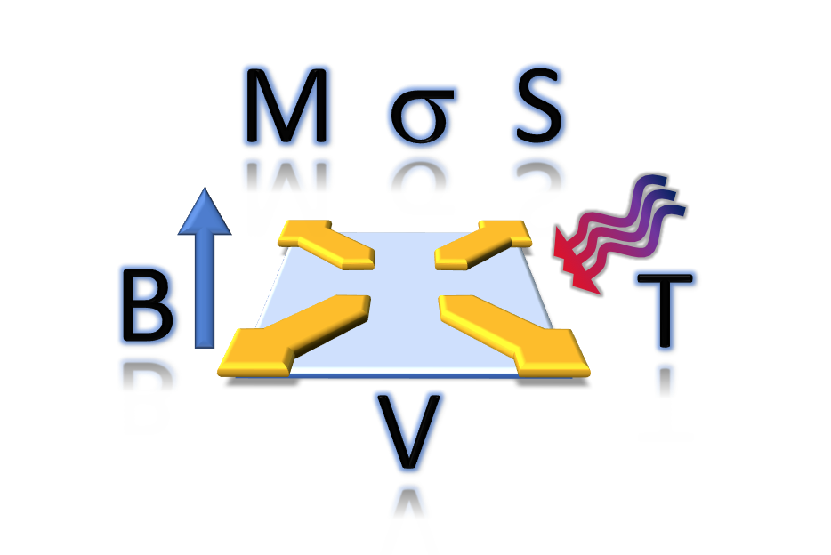
Commercial and Funding Success
TEM detector commercialization
Glasgow condensed matter, particle physics and Institute for Gravitational Research.
High speed imaging detectors for TEM
Six units, £0.7M
Larger grants including
Phil King (St Andrews): over £2.9M in funding, including for new facility in spin-resolved imaging.
Several >£1M grants, joint with Chemistry and biology departments.
Fellowships, e.g. Rost (St.A.), EPSRC early career,
Gerardot (H-W) RAEng Emerging Technology Chair , Wolfson Merit, ERC
– prompting 2 lower level appointments in CMP@H-W

Slide 6
Summary
The Condensed Matter and Materials Physics theme is in great shape: healthy recruitment of world-class staff, a strong stream of PhD candidates, and recent investment in top-end experimental facilities.
No perceptible barriers to collaborations across Scottish Physics – has SUPA done it’s job?
How can SUPA III help in the future ? Perhaps SUPA’s could facilitate groupings themed along grand challenge priorities matched to funding streams from UKRI & EU funders e.g. 21st Century Products, Digital Manufacturing, Sustainable Industries, New Industrial Systems. Could/Should be cross-pool too.

