Slide 1
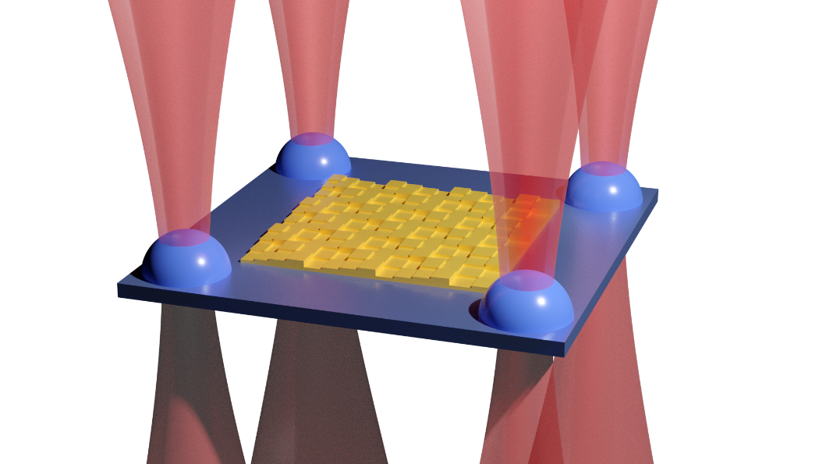
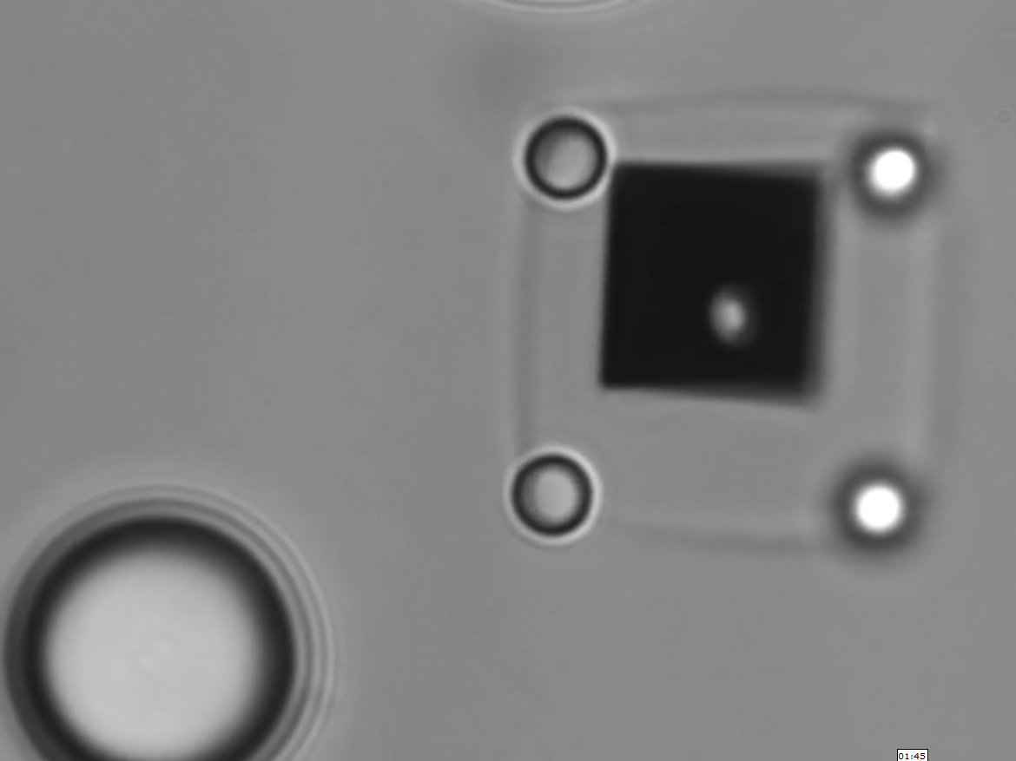
Optomechanical Stabilisation of Optically Trapped Metasurface Membranes
Tomasz Plaskocinski
Additional Authors: M. Askari, L. Yan, M.B.H. Abadi, T. Cizmar, A. Di Falco
Additional Institution: University of St. Andrews
Funders: ERC, EPSRC
Abstract
In recent years, metasurfaces have emerged as a fascinating way of controlling the behaviour of light through exact control of boundary conditions. My work revolves around using these metasurfaces to stabilise and precisely measure forces incident on optically trapped membranes in a microfluidic environment, with applications in cell and DNA biology.
Membrane Concept Design and Optical Trapping Demonstration
Project Description
First, the membranes will be fabricated combining electron beam lithography and nanofabrication methods, and a consistent design will be formulated.
The membrane motion will then be thoroughly characterised through phase and back-plane interferometry. Focus will be on measuring the membrane displacement in the z direction, which is intrinsically the most stable.
Finally, metasurfaces for further stabilisation of the membranes will be designed and fabricated on top of them. This will be followed by single force molecule spectroscopy experiments, with further potential of using the metasurface membranes as conformable in-situ optical elements.
Conclusions and Future Work
Intrinsically stable platform for single molecule force spectroscopy
Novel approach of combining optical manipulation with metasurfaces
Successful fabrication and optical trapping of membranes achieved
Interferometer and metasurface design in progress
Refs & links Askari, M. et al., All-optical manipulation of photonic membranes. Opt. Express 29, 14260-14268 (2021)
https://synthopt.wp.st-andrews.ac.uk/

