Slide 1
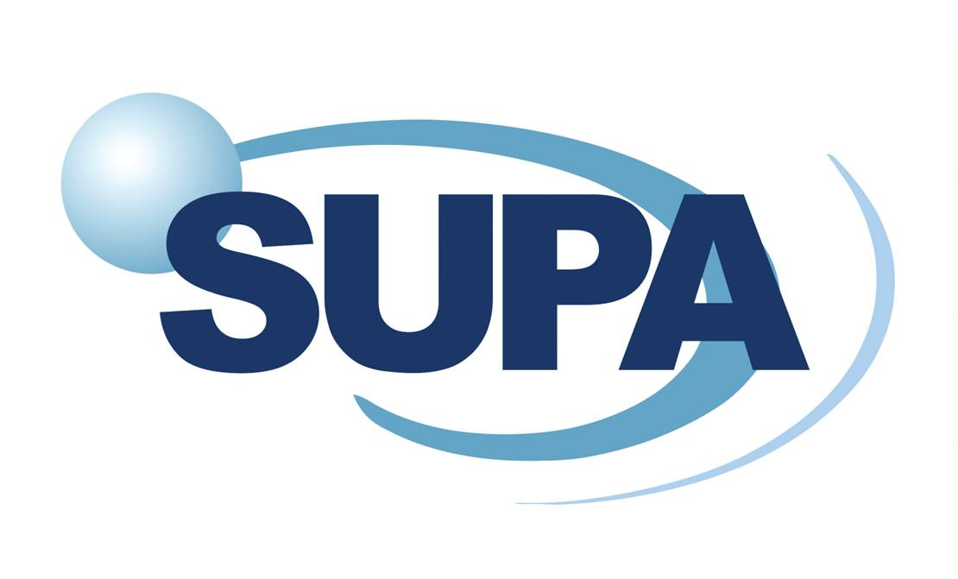
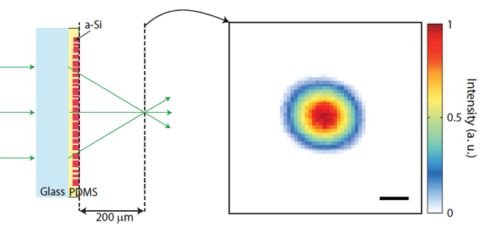
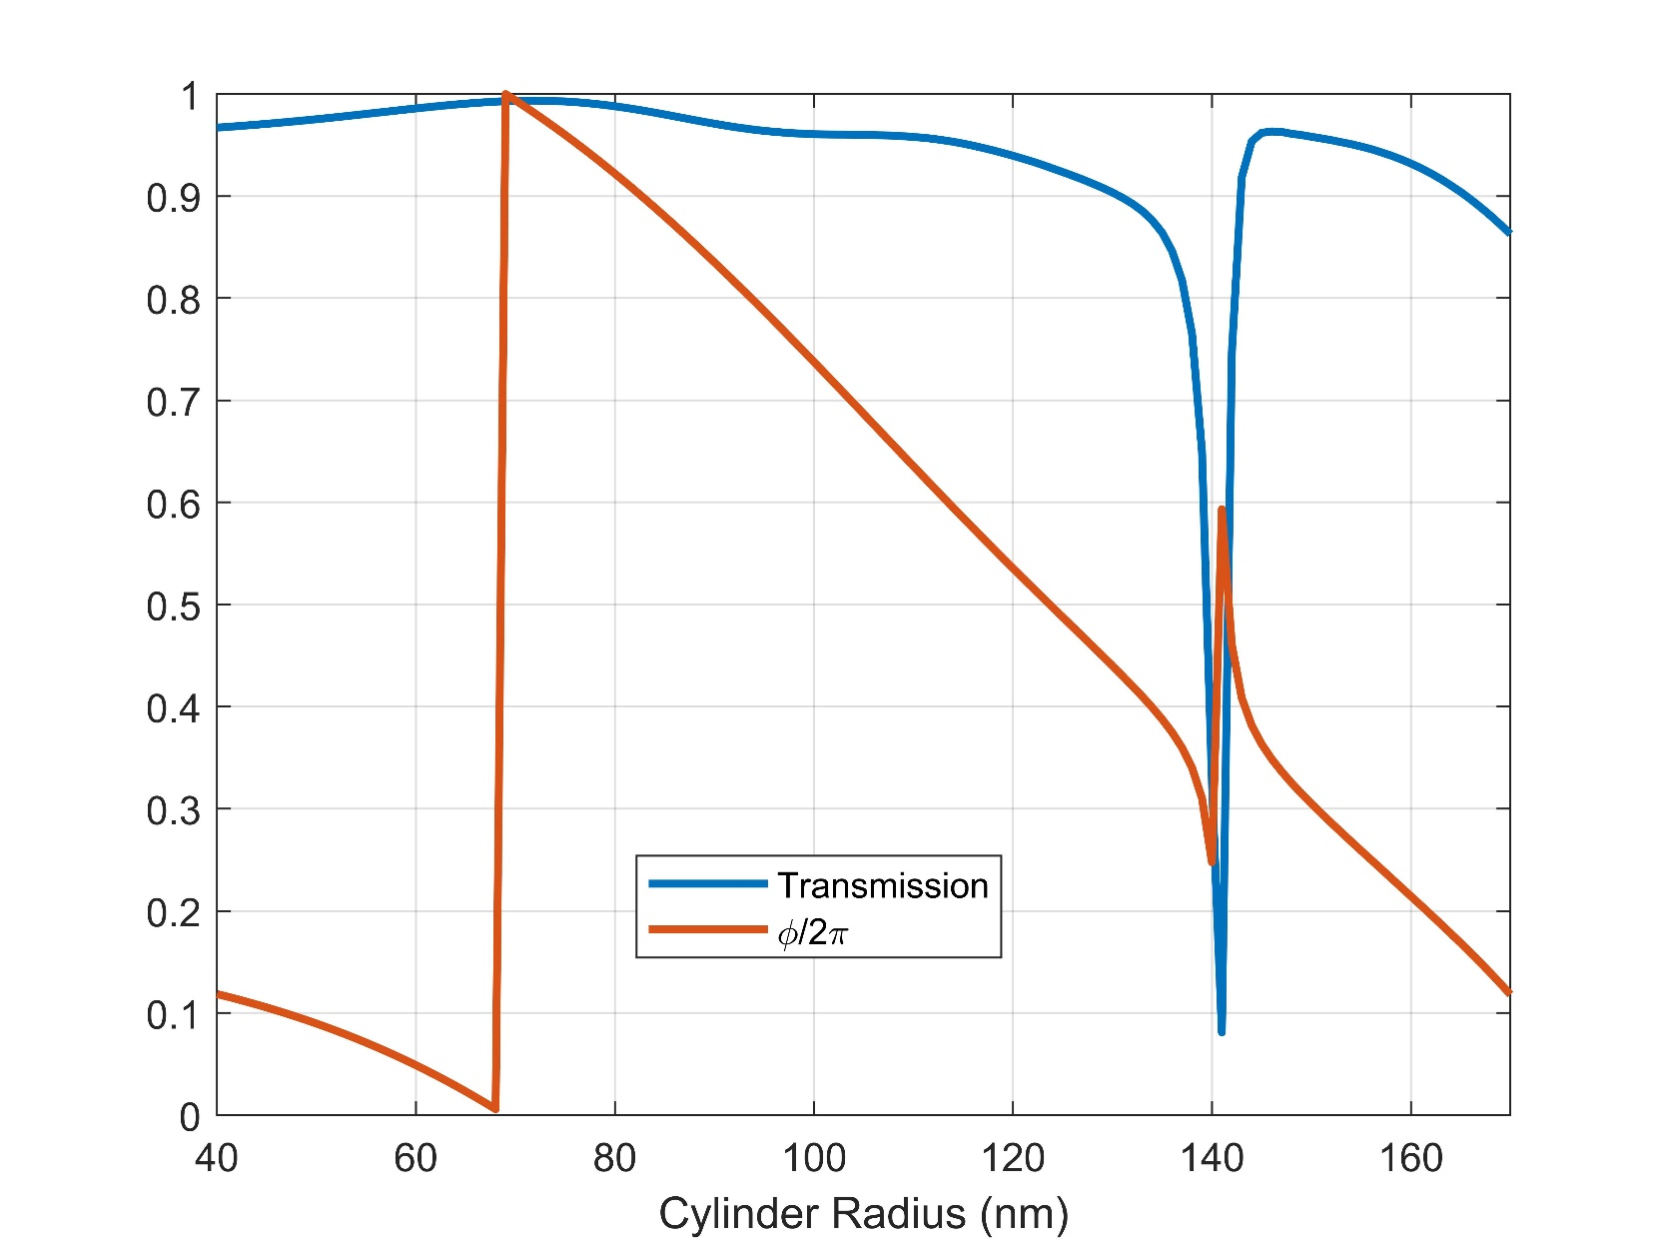
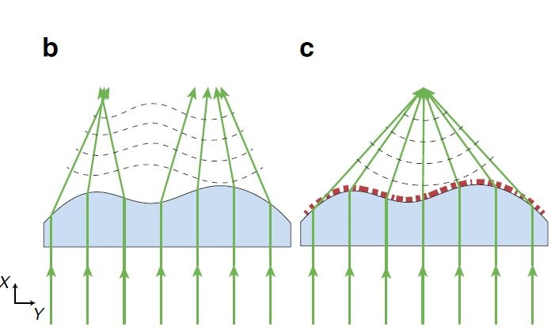
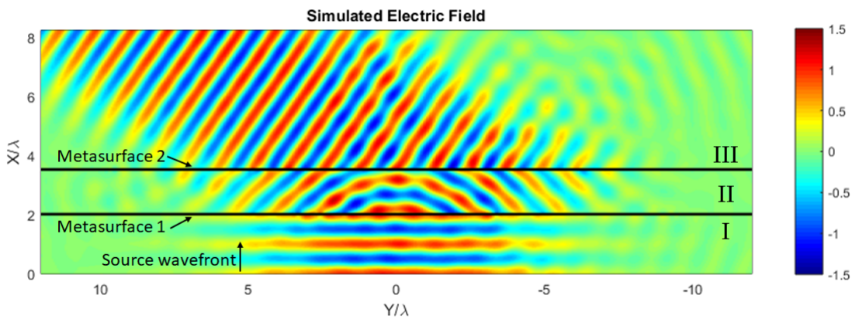
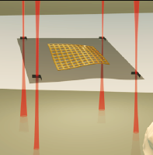
All Dielectric Metasurfaces for biophotonic Applications
Mohammad Biabanifard
Additional Author: Andrea Di Falco
Funder: ERC
Abstract
new optical structures within the scale of a few hundred nanometre are emerging to engineer full-scale light
characterisations:
polarisation, Amplitude, and phase.
Fabrication
[2]
Flexible All-dielectric Metasurfaces not
only goes beyond diffraction limit but also take the advantage of new engineered wavefront, introducing numerous novel practical tools specially for biophotonic imaging purposes in microfluidic environment.
Project Description
Metasurfaces, a two
-dimensional version
of metamaterials,
by having unusual
scattering properties
introduces the ability to engineer the wavefront as desired. In this regard, dielectric metasurfaces are more efficient in transmission compared with the metal ones and they could take advantage of being broadband. These dielectric metasurfaces are designed to be exploited for imaging and sensing biophotonic applications in microfluidic environments.
[3]
References
[1] Reader-Harris, Peter, Blair C. Kirkpatrick, and Andrea Di Falco. "Design and applications of flexible photonic membranes." In Quantum Sensing and Nanophotonic Devices XI, vol. 8993, p. 89930P. International Society for Optics and Photonics, 2014.
[2] Kamali, Seyedeh Mahsa, Amir Arbabi, Ehsan Arbabi, Yu Horie, and Andrei Faraon. "Decoupling optical function and geometrical form using conformal flexible dielectric metasurfaces." Nature communications 7, no. 1 (2016): 1-7.
[3] Raeker, Brian O., and Anthonv Grbic. "Paired metasurfaces for amplitude and phase control of wavefronts." In 2018 IEEE International Symposium on Antennas and Propagation & USNC/URSI National Radio Science Meeting, pp. 1479-1480. IEEE, 2018.

